Slide 1
Understanding the electrical principles associated with the design, building, installation and maintenance of electrical equipment and systems
Outcome 4: Understand the relationship between resistance, resistivity, voltage, current and power
Session 1 Electrons and charge

Slide 2
Outcome 4
Understand the relationship between resistance, resistivity, voltage, current and power
By the end of this outcome you will have had the opportunity to:
describe the basic principles of electron theory
identify and differentiate between materials which are good conductors and insulators
state the types and properties of different electrical cables
describe what is meant by resistance and resistivity in relation to electrical circuits
explain the relationship between current, voltage and resistance in parallel and series d.c. circuits
calculate the values of current, voltage and resistance in parallel and series d.c. circuits
calculate values of power in parallel and series d.c. circuits
state what is meant by the term voltage drop in relation to electrical circuits
describe the chemical and thermal effects of electrical currents.

Slide 3
Session 1
In this session the student will have the opportunity:
  Describe the basic principles of electron theory.

Slide 4
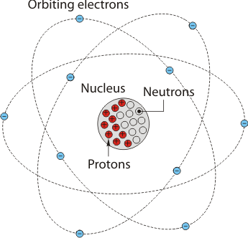
Atoms
Everything around us is made up of atoms
An atom is made up of a number of different particles
`Electrons’ `protons’ and `neutrons’
To decide what makes a good conductor or insulator we have to look at what it is made of.
The centre of the atom is the nucleus
The nucleus contains a number of protons and the same number of neutrons
Simplified atom

Slide 5
Atoms
Protons have a positive electrical charge.
Electrons have a negative electrical charge.
The electrons are held in their orbit by the attraction that each of the electrical charges has for each other.
Protons attract electrons.

Slide 6
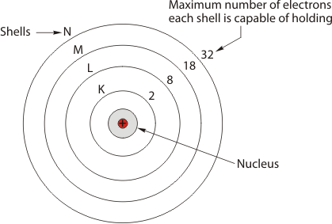
Maximum Electrons in Each Shell
The electrons are held in their orbit, by the attraction that each electrical charge has for one another.
The distance away from the nucleus varies according to the energy the electron has.
Electrons orbit in levels or shells that are given labels K L M and N.
There is a set number of electrons that can inhabit each level.

Slide 7
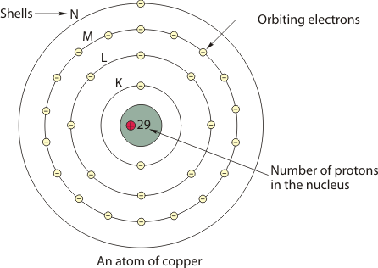
An Atom of Copper

Slide 8
An Atom of Copper
Electrons and protons have electrical charge, and if there becomes an imbalance between the two, the atom becomes electrically charged
It is then described as a positive or negative ion.
When an atom has energy applied to it, it will either gain or lose an electron.
This happens when there was only one or two electrons orbiting the outer shell as we saw in the copper atom.
It is easy for small amounts of energy to displace these electrons.
This is what makes copper a good conductor.

Slide 9
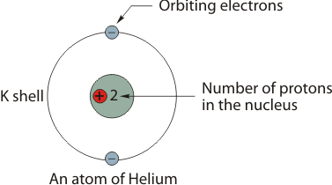
An Atom of Helium
Helium has a full outer shell and is therefore very stable, so it is difficult for it to react when energy is applied to it.
This makes it a good insulator.
When electrons form part of a complete shell, as with the helium, they are said to be bonded electrons.
When the shell is not full, as with the copper, the electrons are called free electrons.

Slide 10
Current Flow
Electricity is considered to be a flow of electrons.
Atoms, electrons and protons are very important in understanding how and why electricity works.
When a voltage is applied to a conductor, the electrons are supplied with energy.
This energy forces electrons to move out of one orbit of an atom and attach itself to the orbit of another neighbouring atom.
This continues along the conductor.
This flow of electrons then becomes the current or current flow.

Slide 11
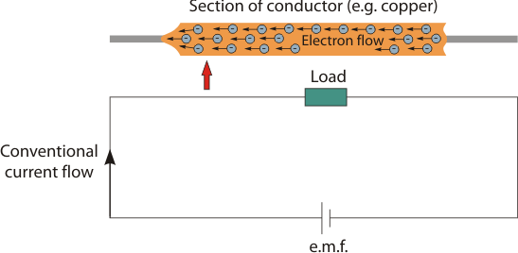
Current Flow
For the current to flow there must be;
A complete circuit
A force applied to drive the electrons around the circuit

Slide 12
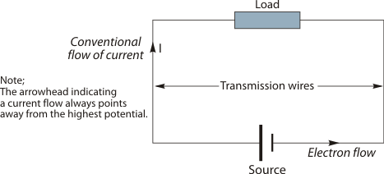
Current Flow
For current to flow there must be
a source of energy –
  a generator etc
a load –
which could be a lamp etc
a means of transmitting –
wires etc
The direction of the current has two terms;
Conventional current flow, which starts at the positive terminal, flows around the circuit and returns to the negative.
Electron flow, which is a flow of electrons meaning that the current actually flows from the negative to the positive terminal

Slide 13
Measuring electricity
The unit of electrical quantity is the coulomb.
The definition of a coulomb is;
The quantity of electricity passing through a certain point in a circuit when a current of 1 amp is maintained for 1 second.
The SI unit for current is the amp
Current is the rate at which electricity flows around a circuit
The equation for measuring current flow is Q = It or Q = I x t
Where Q = quantity of electricity (C)
I = current (A)
t = time (s)

Slide 14
Multi choice questions

Slide 15
1. What is everything around us made up of?
a) Neutrons
b) Atoms
c) Electrons
d) Electric particles
2. What are atoms made up of?
a) `Electrons’ `protons’ and `neutrons’
b) `Nucleus’ `protons’ and `neutrons’
c) `Electrons’ `nucleus’ and `neutrons’
d) `Electrons’ `protons’ and ` nucleus’
3. What sort of charge do protons have?
a) Negative
b) Positive
c) Dual
d) High

Slide 16
4. What sort of charge do electrons have?
a) Negative
b) Positive
c) Dual
d) High
5. What makes a good conductor?
a) An atom with few electrons in the outer shell
b) An atom with lots of electrons in the outer shell
c) An atom with few protons in the outer shell
An atom with lots of protons in the outer shell
6. What makes a good insulator?
a) An atom with few electrons in the outer shell
b) An atom with lots of electrons in the outer shell
c) An atom with few protons in the outer shell
d) An atom with lots of protons in the outer shell

Slide 17
7. What is electricity considered to be?
a) Something that makes electrical appliances work
b) Something that only skilled people can work on
c) A flow of electrons
d) All of the above
8. What happens when a voltage is supplied to a conductor?
a) The electrons wakes up
b) It receives energy
c) The nucleus becomes active
d) The protons lose their charge
9. When energy is supplied to an atom what happens ?
a) Nothing
b) It explodes
c) The electrons move from one atom to another
The electrons move faster inside the atom

Slide 18
10. For current to flow in a circuit what must there be?
a) A complete circuit and something to drive the electrons around the circuit
b) Plenty of energised electrons
c) A load of some sort in the circuit
d) All of the above
11. Where does conventional current flow start from?
a) The negative terminal
b) The load
c) The positive terminal
d) Don’t know
12. The unit for electrical quantity is the?
a) Amp
b) Coulomb
c) Watt
Power
End of session 1

